Slide 1
ADVANCED TRAUMA LIFE SUPPORT (ATLS)
Onwong’a Isaac Nyabuto

Slide 2
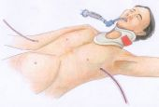
Initial Assessment and Management of the Trauma Patient- ATLS

Slide 3
Epidemiology
Trimodal Distribution of Trauma Deaths
Golden Hour = 80% of trauma deaths in first hour after injury
Rapid trauma care has greatest level of impact in these patients
50%
30%
20%
Immediately
Hours
Days/Weeks

Slide 4
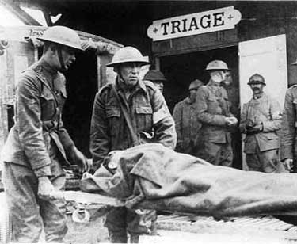
History of Trauma System Development
Standardized Trauma Assessment
  Nebraska Cornfield, 1976
  Orthopedic Surgeon
  Lead to development of ATLS
Trauma Systems Development
  First developed my military in wartime
    i.e. MASH Units
  Expanded to Level 1, 2, 3 Trauma Centers
    Urban Systems
    Statewide networks of systems/Refferal systems
    Level 1 – Highest level of care, Leaders in research, clinical care and education
    Level 2 – Provides definitive care in wide range of complex traumatic patients
    Level 3 – Provides initial stabilization and treatment. May care for uncomplicated trauma patients
    Level 4 – Provides initial stabilization and transfers all trauma patients for definitive care
    WHERE ARE WE IN KENYA?????

Slide 5
Mechanisms of Injury
Blunt Trauma
  Compression Forces
    Cells in tissues are compressed and crushed
    E.g. Spleen
  Shear Forces
    Acceleration/Deceleration Injury
    E.g. Aorta
      Shearing force = Spectrum from Full thickness tear (Exsanguination) to Partial tear (Pseudoaneurysm)
  Overpressure
    Body cavity compressed at a rate faster than the tissue around it, resulting in rupture of the closed space
    E.g. Plastic bag
    E.g. in trauma = diaphragmatic rupture, bladder injury

Slide 6
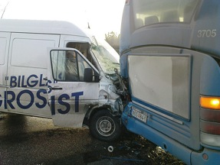
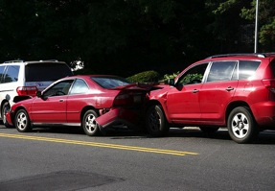
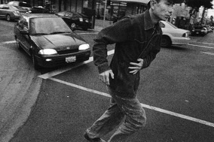
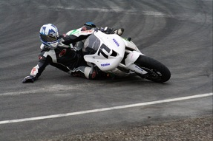
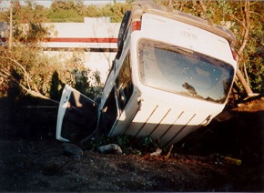
Mechanisms of Injury
Frontal Impact Collisions
Lateral Impact Collisions (T bone)
Rear Impact Collisions
Rollover Mechanism
Open Vehicle or Motorcycle/Moped
Pedestrian Vs. Car
Penetrating Injury (Guns vs. Knives)
Nico.se (flickr)
Vincent J Brown (flickr)
Nxtiak (flickr)

Slide 7
Basics of Trauma Assessment
Preparation
  Team Assembly
  Equipment Check
Triage
  Sort patients by level of acuity (SATS)
Primary Survey
  Designed to identify injuries that are immediately life threatening and to treat them as they are identified
Resuscitation
  Rapid procedures and treatment to treat injuries found in primary survey before completing the secondary survey
Secondary Survey
  Full History and Physical Exam to evaluate for other traumatic injuries
Monitoring and Evaluation, Secondary adjuncts
Transfer to Definitive Care
  ICU, Ward, Operating Theatre, Another facility

Slide 8
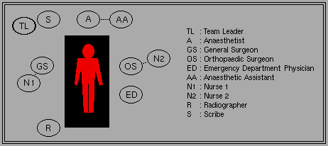
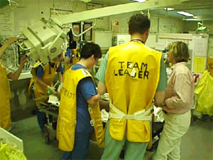
Preparation . . .
Organize Trauma Response Team

Slide 9
Primary Survey
Airway and Protection of Spinal Cord
Breathing and Ventilation
Circulation
Disability
Exposure and Control of the Environment

Slide 10
Primary Survey
Key Principles
  When you find a problem during the primary survey, FIX IT.
  If the patient gets worse, restart from the beginning of the primary survey
  Some critical patients in the Emergency Department may not progress beyond the primary survey

Slide 11
Airway and Protection of Spinal Cord
Why first in the algorithm?
  Loss of airway can result in death in < 3 minutes
  Prolonged hypoxia = Inadequate perfusion, End-organ damage
Airway Assessment
  Vital Signs = RR, O2 sat
  Mental Status = Agitation, Somnolent, Coma
  Airway Patency = Secretions, Stridor, Obstruction
  Traumatic Injury above the clavicles
  Ventilation Status = Accessory muscle use, Retractions, Wheezing
Clinical Pearls
  Patients who are speaking normally generally do not have a need for immediate airway management
  Hoarse or weak voice may indicate a subtle tracheal or laryngeal injury
  Noisy Respirations frequently indicates an obstructed respiratory pattern

Slide 12
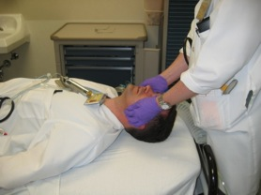
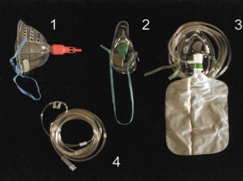
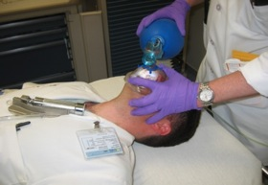
Airway Interventions
Maintenance of Airway Patency
  Suction of Secretions
  Chin Lift/Jaw thrust
  Nasopharyngeal Airway
  Definitive Airway
Airway Support
  Oxygen
  NRBM (100%)
  Bag Valve Mask
  Definitive Airway
Definitive Airway
  Endotracheal Intubation
    In-line cervical stabilization
  Surgical Crichothyroidotomy
Source undetermined
Source undetermined

Slide 13
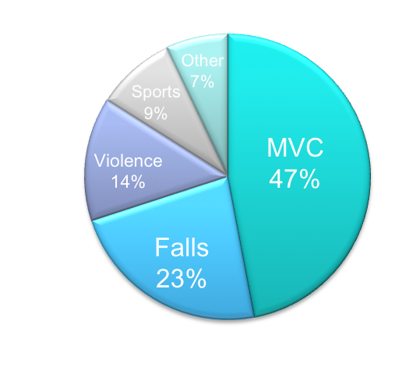
Protection of Spinal Cord
General Principle: Protect the entire spinal cord until injury has been excluded by radiography or clinical physical exam in patients with potential spinal cord injury.
Spinal Protection
  Rigid Cervical Spinal Collar = Cervical Spine
  Long rigid spinal board or immobilization on flat surface such as stretcher = T/L Spine
Etiology of Spinal Cord Injury
  Road Traffic Accidents (47%)
  High energy falls (23%)
Clinical Pearls
  Treatment (Immobilization) before diagnosis
  Return head to neutral position
  Do not apply traction
  Diagnosis of spinal cord injury should not precede resuscitation
  Motor vehicle crashes and falls are most commonly associated with spinal cord injuries
  Main focus = Prevention of further injury

Slide 14
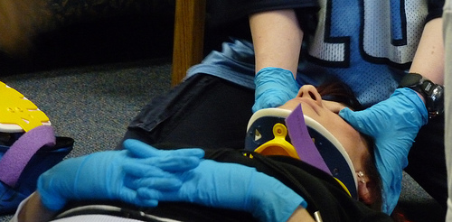
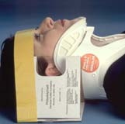
Cervical spine Immobilization
Return head to neutral position
Maintain in-line stabilization
Correct size collar application
Blocks/tape
Sandbags
Source:
www.ossur.com/bracesandsupports/neckandspine/prehospit...oncollars/phillyblockhead
Accessed 9/20/09
Yahoo Images
Paladinsf (flickr)

Slide 15
Breathing and Ventilation
General Principle: Adequate gas exchange is required to maximize patient oxygenation and carbon dioxide elimination
Breathing/Ventilation Assessment:
  Exposure of chest
  General Inspection
    Tracheal Deviation
    Accessory Muscle Use
    Retractions
    Absence of spontaneous breathing
    Paradoxical chest wall movement
  Auscultation to assess for gas exchange
    Equal Bilaterally
    Diminished or Absent breath sounds
  Palpation
    Deviated Trachea
    Broken ribs
    Injuries to chest wall

Slide 16
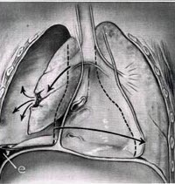
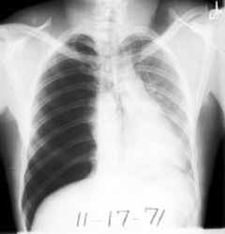
Breathing and Ventilation
Identify Life Threatening Injuries
  Tension Pneumothorax
    Air trapping in the pleural space between the lung and chest wall
    Sufficient pressure builds up and pressure to compress the lungs and shift the mediastinum
    Physical exam
      Absent breath sounds
      Air hunger
      Distended neck veins
      Tracheal shift
    Treatment
      Needle Decompression
        2nd Intercostal space, Midclavicular line
      Tube Thoracostomy
        5th Intercostal space, Anterior axillary line
Delldot (wikimedia)
Source: www.meddean.luc.edu lumenMedEd/medicine/pulmonar/cxr/pneumo1.htm
Accessed 9/20/09 – Yahoo Images

Slide 17
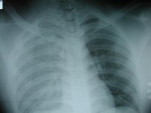
Breathing and Ventilation
Hemothorax
  Blood collecting in the pleural space and is common after penetrating and blunt chest trauma
  Source of bleeding = Lung, Chest wall (intercostal arteries), heart, great vessels (Aorta), Diaphragm
  Physical Exam
    Absent or diminished breath sounds
    Dullness to percussion over chest
    Hemodynamic instability
  Treatment = Large Caliber Tube Thoracostomy
    10-20% of cases will require Thoracotomy for control of bleeding

Slide 18
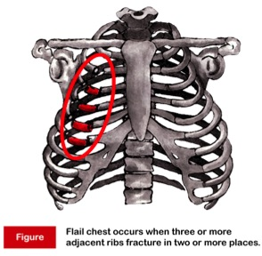
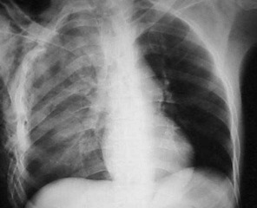
Breathing and Ventilation
Flail Chest
  Direct injury to the chest resulting in an unstable segment of the chest wall that moves separately from remainder of thoracic cage
  Typically results from two or more fractures on 2 or more ribs
  Typically Accompanied by a pulmonary contusion
  Physical Exam = Paradoxical movement of chest segment
  Treatment = Improve Abnormalities in gas exchange
    Early Intubation for patients with respiratory distress
    Avoidance of overaggressive fluid resuscitation

Slide 19
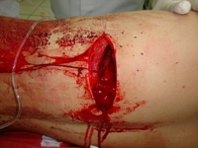
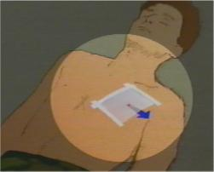
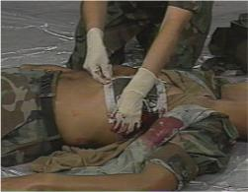
Breathing and Ventilation
Open Pneumothorax
  Sucking Chest Wound
  Large defect of chest wall
    Leads to rapid equilibration of atmospheric and intrathoracic pressure
    Impairs oxygenation and ventilation
  Initial Treatment
    Three Sided occlusive dressing
    Provides a flutter valve effect
    Chest tube placement remote to site of wound
    Avoid complete dressing, will create a tension pneumothorax

Slide 20
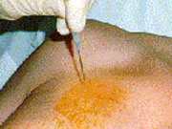
Needle Thoracostomy
Needle Thoracostomy
  Midclavicular line
  14 guage angiocath
  Over the 2nd rib
  Rush of air is heard

Slide 21
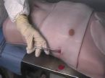
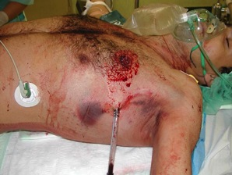
Tube Thoracostomy
Insertion site
  5th intercostal space,
  Anterior axillary line
Sterile prep, anesthesia with lidocaine
2-3 cm incision along rib margin with #10 blade
Dissect through subcutaneous tissues to rib margin
Puncture the pleura over the rib
Advance chest tube with clamp and direct posteriorly and apically
Observe for fogging of chest tube, blood output
Suture the tube in place
Complications of Chest Tube Placement
  Injury to intercostal nerve, artery, vein
  Injury to lung
  Injury to mediastinum
  Infection
  Allergic reaction to lidocaine
  Inappropriate Placement of chest tube

Slide 22
Circulation
Shock
  Impaired tissue perfusion
  Tissue oxygenation is inadequate to meet metabolic demand
  Prolonged shock state leads to multiorgan system failure and cell death
Clinical Signs of Shock
  Altered mental status
  Tachycardia (HR > 100) = Most common sign
  Arterial Hypotension (SBP < 120)
    Femoral Pulse – SBP > 80
    Radial Pulse – SBP > 90
    Carotid Pulse – SBP > 60
  Inadequate Tissue Perfusion
    Pale skin color
    Cool clammy skin
    Delayed cap refill (> 3 seconds)
    Altered LOC
    Decreased Urine Output (UOP < 0.5 mL/kg/hr)

Slide 23
Circulation
Types of Shock in Trauma
  Hemorrhagic
    Assume hemorrhagic shock in all trauma patients until proven otherwise
    Results from Internal or External Bleeding
  Obstructive
    Cardiac Tamponade
    Tension Pneumothorax
  Neurogenic
    Spinal Cord injury
Sources of Bleeding
  Chest
  Abdomen
  Pelvis
  Bilateral Femur Fractures

Slide 24
Circulation
Emergency Nursing Treatment
  Two Large IV Lines
  Cardiac Monitor
  Blood Pressure Monitoring
General Treatment Principles
  Stop the bleeding
    Apply direct pressure
    Temporarily close scalp lacerations
  Close open-book pelvic fractures
    Abdominal pelvic binder/bedsheet
  Restore circulating volume
    Crystalloid Resuscitation (2L)
    Administer Blood Products
  Immobilize fractures
Responders vs. Nonresponders
  Transient Response to volume resuscitation = sign of ongoing blood loss
  Nonresponders = Consider other source for shock state or operating room for control of massive hemorrhage

Slide 25
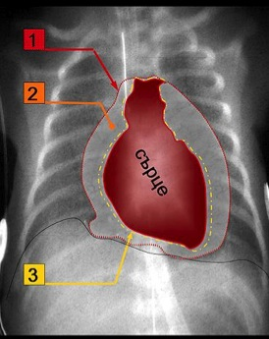
Circulation
Pericardial Tamponade
  Pericardium or sac around heart fills with blood due to penetrating or blunt injury to chest
  Beck’s Triad
    Distended jugular veins
    Hypotension
    Muffled Heart Sounds
  Treatment
    Rapid evacuation of pericardial space
    Performed through a Pericardiocentesis (temporizing measure)
    Open Thoracotomy
Pericardium
Blood
Heart
Epicardium
Aceofhearts1968 (Wikimedia)

Slide 26
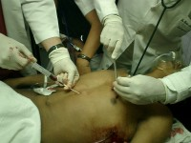
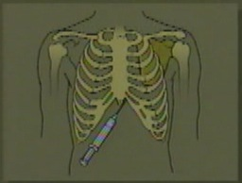
Pericardiocentesis
Puncture the skin 1-2 cm inferior to xiphoid process
45/45/45 degree angle
Advance needle to tip of left scapula
Withdraw on needle during advance of needle
Preferable under ultrasound guidance or EKG lead V attachment
Complications
  Aspiration of ventricular blood
  Laceration of coronary arteries, veins, epicardium/myocardium
  Cardiac arrhythmia
  Pneumothorax
  Puncture of esophagus
  Puncture of peritoneum

Slide 27
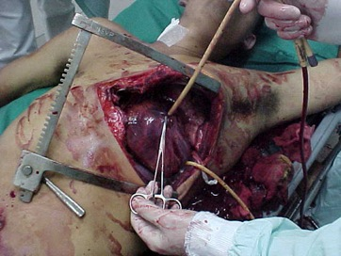
Circulation
A word about cardiac arrest . . .
  Care of the trauma patient in cardiac arrest
    CPR
    Bilateral Tube Thoracostomy
    Pericardiocentesis
    Volume Resuscitation
  Traumatic Cardiac Arrest due to blunt injury has very low survival rate (< 1%)
    No point for emergency thoracotomy
  Selected cases of cardiac arrest due to penetrating traumatic injury may benefit from emergent thoracotomy
    Pericardial tamponade
    Cross clamp Aorta

Slide 28
Disability
Baseline Neurologic Exam
  Pupillary Exam
    Dilated pupil – suggests transtentorial herniation on ipsilateral side
  AVPU Scale
    Alert
    Responds to verbal stimulation
    Responds to pain
    Unresponsive
  Gross Neurological Exam – Extremity Movement
    Equal and symmetric
    Normal gross sensation
  Glasgow Coma Scale: 3-15
  Rectal Exam
    Normal Rectal Tone
Note: If intubation prior to neuro assessment, consider quick neuro assessment to determine degree of injury

Slide 29
Disability
GCS ≤ 8
Intubate
Glasgow Coma Scale
  Eye
    Spontaneously opens 4
    To verbal command 3
    To pain 2
    No response 1
  Best Motor Response
    Obeys verbal commands 6
    Localizes to pain 5
    Withdraws from pain 4
    Flexion to pain (Decorticate Posturing) 3
    Extension to pain (Decerebrate Posturing) 2
    No response 1
  Verbal Response
    Oriented/Conversant 5
    Disoriented/Confused 4
    Inappropriate words 3
    Incomprehensible words 2
    No response 1
Ghana Emergency Medicine Collaborative
Advanced Emergency Trauma Course

Slide 30
Disability
Key Principles
  Precise diagnosis is not necessary at this point in evaluation
  Prevention of further injury and identification of neurologic injury is the goal
  Decreased level of consciousness = Head injury until proven otherwise
  Maintenance of adequate cerebral perfusion is key to prevention of further brain injury
    Adequate oxygenation
    Avoid hypotension
  Involve neurosurgeon early for clear intracranial lesions

Slide 31
Disability
Cervical Spinal Clearance
  Patients must be alert and oriented to person, place and time
  Not clinically intoxicated with alcohol or drugs
  Non-tender at all spinous processes
  No focal neurological deficits
  No distracting injuries
  Painless range of motion of neck

Slide 32
Exposure
Remove all clothing
  Examine for other signs of injury
  Injuries cannot be diagnosed until seen by provider
Logroll the patient to examine patient’s back
  Maintain cervical spinal immobilization
  Palpate along thoracic and lumbar spine
  Minimum of 3 people, often more providers required
Avoid hypothermia
  Apply warm blankets after removing clothes
  Hypothermia = Coagulopathy
    Increases risk of hemorrhage

Slide 33
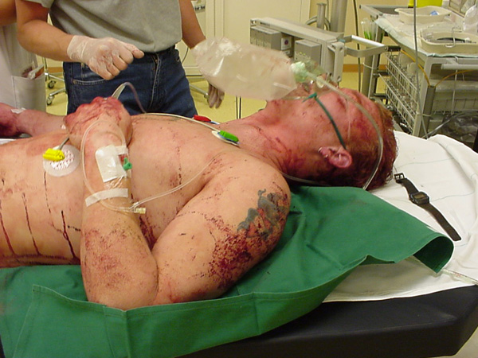
Exposure

Slide 34
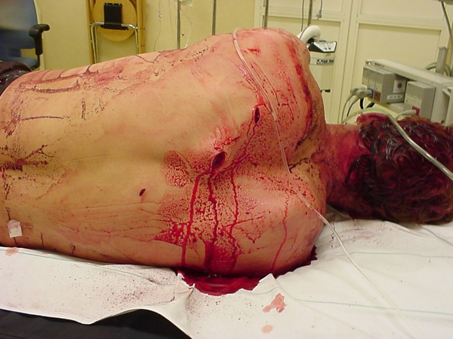
Exposure

Slide 35
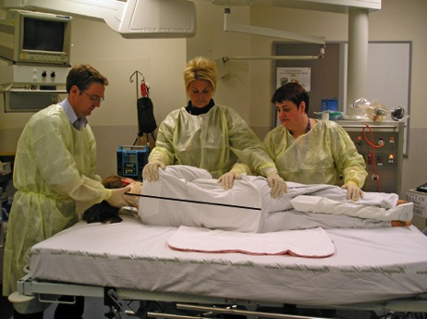
Trauma Logroll
One person = Cervical Spine
Two people = Roll main body
One person = Inspect back and palpate spine

Slide 36
Secondary Survey
Secondary Survey is completed after primary survey is completed and patient has been adequately resuscitated.
No patient with abnormal vital signs should proceed through a secondary survey
Secondary Survey includes a brief history and complete physical exam

Slide 37
History
AMPLE History
  Allergies
  Medications
  Past Medical History, Pregnancy
  Last Meal
  Events surrounding injury, Environment
History may need to be gathered from family members or ambulance service

Slide 38
Physical Exam
Head/HEENT
Neck
Chest
Abdomen
Pelvis
Genitourinary
Extremities
Neurologic

Slide 39
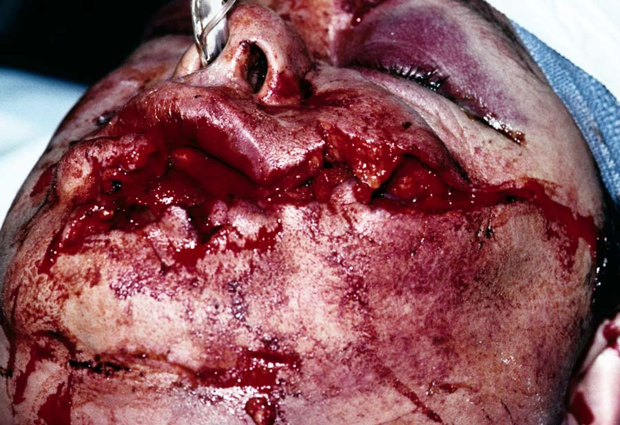
Physical Exam
Difficult Airway
Source Undetermined

Slide 40
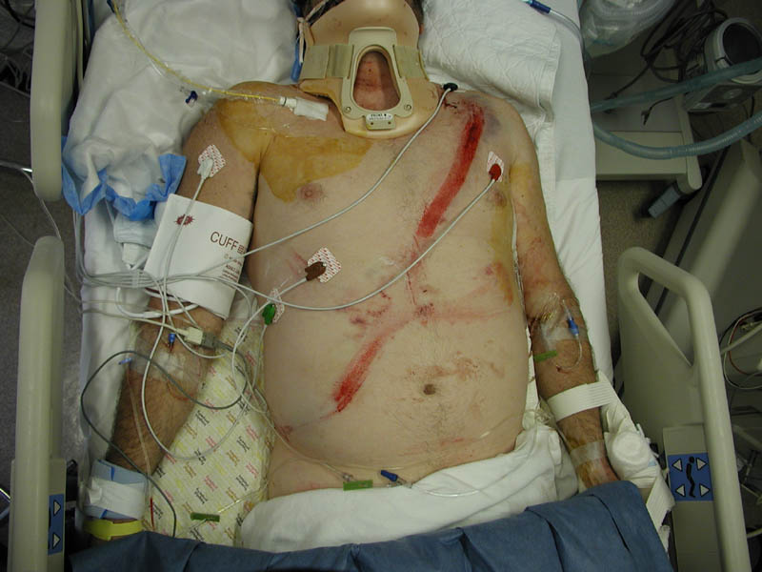
Physical Exam
Seatbelt sign

Slide 41




Physical Exam
Battle Sign
Raccoon's Eyes
Cullen’s Sign
Grey-Turner Sign
H. L. Fred and H.A. van Dijk (Wikimedia)

Slide 42
Adjuncts to Secondary Survey
Radiology
  Standard emergent films
    C-spine, CXR, Pelvis
  Focused Abdominal Sonography in Trauma (FAST)
  Additional films
    Cat scan imaging
    Angiography
Foley Catheter
  Blood at urethral meatus = No Foley catheter
Pain Control
Tetanus Status
Antibiotics for open fractures

Slide 43
Trauma in Special Populations
Pregnancy
  Supine Hypotensive Syndrome
    After 20 weeks, enlarged uterus with fetus and amniotic fluid compresses inferior vena cava
    Decreases venous return and decrease cardiac output
    Keep pregnant patients in left lateral decubitus position to avoid excessive hypotension
  Optimal maternal and fetal outcome is determined by adequate resuscitation of mother
  Fetal Monitoring

Slide 44
Trauma in Special Populations
Pediatric Trauma Resuscitation
  Differences in head to body ratio and relative size and location of anatomic features make children more susceptible to head injury, abdominal injury
  Underdeveloped anatomy leads to chest pliability and less protection of thoracic cage
  Cardiac Arrest
    Typically result from respiratory arrest degrading into cardiac arrest
  Resuscitation
    Broselow Tape
    ABCDE

Slide 45

Classic Radiographical Findings
Pelvic Fracture

Slide 46
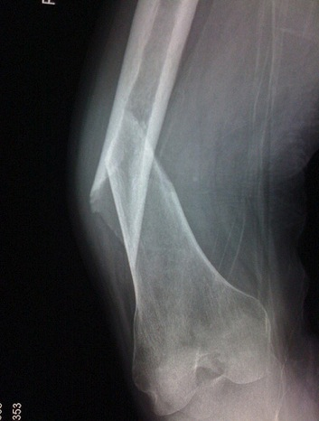
Classic Radiographic Findings
Femur Fracture

Slide 47
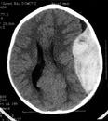
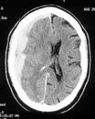
Classic Radiographic Findings
Epidural Hematoma
  Middle Meningeal Artery
Subdural Hematoma
  Bridging Veins

Slide 48
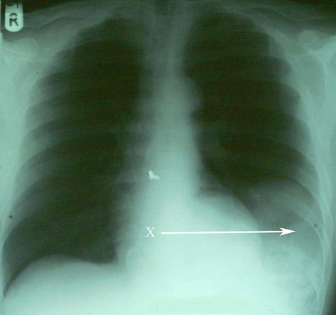
Classic Radiographic Findings
Diaphragmatic Rupture with spleen herniation

Slide 49
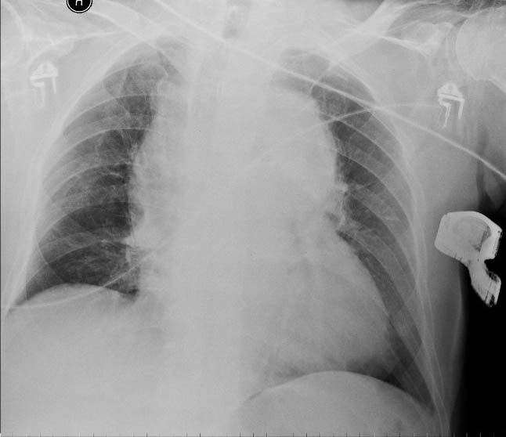
Classic Radiographic Findings
Widened Mediastinum – Aortic Injury

Slide 50
Definitive Care
Secondary Survey followed by radiographic evaluation
  CatScan
  Consultation
    Neurosurgery
    Orthopedic Surgery
    Vascular Surgery
Transfer to Definitive Care
  Operating Room
  ICU
  Higher level facility

Slide 51
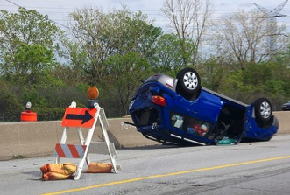
Case Example
Mr. Jones – 45 yr male involved in a rollover road traffic accident and was ejected from the vehicle. Patient was unrestrained. Patient was not ambulatory on scene of accident and is brought into trauma bay for evaluation.
  What concerns you about story?
  First Steps of Evaluation and Management
Pete Prodoehl (flickr)

Slide 52
Case Example
Exam
  Awake, diaphoretic
  Pulse = 120
  BP = 90/60
  RR = 18
  O2 sat = 94%
What do you want to do next?

Slide 53
Case Example
Preparation
Primary Survey
  Awake, alert, talking to provider
  Breathing
    Absent breath sounds on left
    What do you want to do next?
  Circulation
    Vital Signs?
    Access?
    Resuscitation?
  IV/O2/Monitor
  Disability
    GCS = 14
  Exposure

Slide 54
Case Example
Chest tube placed
  Rush of air heard consistent with pneumothorax
Repeat Vital Signs
  Pulse 120
  BP 80/40
  RR = 15
  O2 sat = 99% NRBM
What do you want to do next?
  Patient complaining of abdominal pain
  Ecchymosis noted over left flank
  Resuscitation?

Slide 55
Case Example
Blood Product Administration
Transfer to definitive care = Operating Theatre

Slide 56
Conclusion
Assessment of the trauma patient is a standard algorithm designed to ensure life threatening injuries do not get missed
Primary Survey + Resuscitation
  Airway
  Breathing
  Circulation
  Disability
  Exposure
Secondary Survey
Definitive Care

